Slide 1
TRANSrisk Side Event
‘Assessing mitigation pathway risk and uncertainty: case studies in the Netherlands, Kenya and Chile’
Friday 18th November, 12.30 to 14.00
European Union Pavilion, Area D, Blue Zone
In this workshop we will be presenting the TRANSrisk approach to developing low emission transition pathways, and practical application of this work to a ‘post-Paris’ world. Three case studies will be presented, with the audience invited to participate and give feedback:
Netherlands: Transition pathways in the livestock sector
Chile: Emissions and air pollution reduction in Santiago de Chile
Kenya: the role of renewable energy in transition pathways
Scan here for workshop details Scan here for a TRANSrisk update
Or visit transrisk-project.eu

Slide 2
Low Carbon Transition Pathways
In the LIVESTOCK sector
Eise Spijker
JIN Climate & Sustainability
www.jin.ngo
Annela Anger-Kraavi
CE
www.camecon.com
‘Assessing mitigation pathway risk and uncertainty: case studies in the Netherlands, Kenya and Chile’
18th November 2016 @ COP22, Marrakech

Slide 3
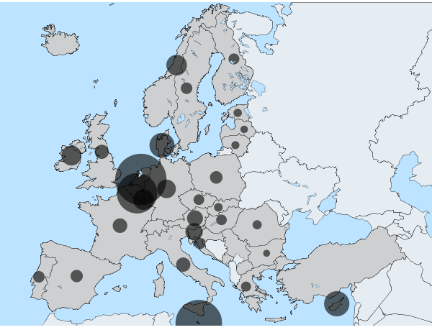
A Low Carbon Transition in the Dutch Livestock Sector
Agricultural sector in the Netherlands
2nd agriculture exporter in the world (in EUR)
4th milk producer in EU (7th herd size)
Largest veal producer in EU
5th largest pig herd in EU
70%
CH₄
70%
N₂O
4%
CO₂
*Livestock densities in EU in 2013 (in LSU / ha)
Source: Eurostat
Livestock sector - ISSUES
Nutrient accumulation (manure)
‘Mega-stables’, Animal-human health
Low milk & meat prices
87%
NH₃
27%
PM₁₀
6%
NO_{X}
Note: emissions percentages are share of national total emissions of that particular pollutant

Slide 4
Transition options for the Dutch Livestock sector (2030)
Low Carbon Transition Pathways
Reduce animal protein consumption
Reduce livestock
Improve conversion efficiency
Primary objective:
Low GHG
Promote low-GHG feeds
Promote energy saving
Produce renewable energy
Promote manure management

Slide 5
Idea Reference: Pink Floyd

Slide 6
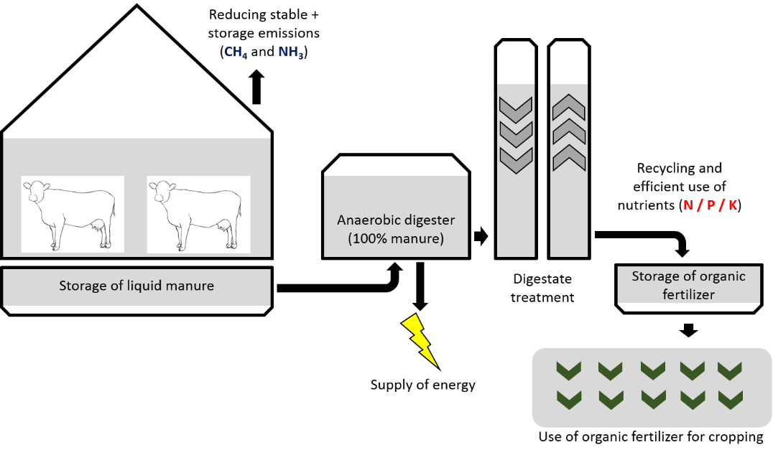
We need Multi-purpose Pathways!!
Observation
NOT all pathways target multiple objectives at the same time
Case study focus on 2 pathways
Reduction Livestock (RL)
Integrated Man. Mngmt (IMM)
Goal
Maximize SYNERGIES
Minimize TRADE-OFFS

Slide 7
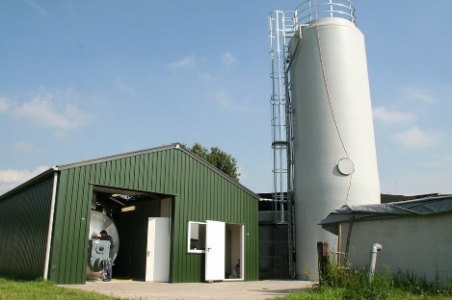
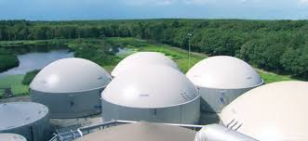
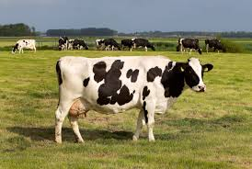
Impact 2 Pathways at National Level RL vs. IMM
2030 GHG targets
- GHG (non-ETS sectors) = -35% (2005)
- CH₄ (national) = -33% (2005)
IMM – requires
Cattle manure
51.8 mln. ton
≈ 10.000 farm-scale plants
CAPEX
≈ 5,2 bln. EUR
Pig manure
11.6 mln. ton
≈ 60 industrial scale plants
CAPEX
≈ 0,6 bln. EUR
RL – requires 37,5% reduction of cattle
2.500.000
1.500.000

Slide 8
Assessing side-effects of 2 pathways ENVIRONMENT
Contribution to target | IMM | RL
Renewable energy
PJ | + | 0
GHG emission reduction
CH₄ – enteric fermentation | 0 | +*
CH₄ – manure management | + | +*
CO₂ – avoidance of fossil fuel | + | 0
Ammonia emissions
Stables & storage | + | +
Application to soil | 0 | +
Nutrient excretion
Nitrates (N) | 0 | +
Phosphates (P) | 0 | +
* Leakage?

Slide 9
Assessing side-effects of 2 pathways SOCIO-ECONOMIC & OTHER
Possible side-effects | IMM | RL
Domestic availability of ‘cheap’ soil nutrients | - | -
Animal health – air quality | + | 0
Animal health – use of antibiotics | + | +*
Animal welfare – grazing time (cattle only) | + / - | + / -
Animal welfare – stable space | + | 0
Human health | + | +*
International competitiveness livestock sector | - | -
Impact on GDP | + / - | -
Employment | + | -
* Leakage?

Slide 10
Modelling Livestock Pathways
Role of modelling:
Assess effect of pathway at national scale
Quantify (yet) (un)known side-effects
Reducing risks & uncertainties for stakeholders
Modelling in this case study:
Macro-econometric Energy-Environment- Economy model - E3ME
Modelling scenarios and comparing them with a selected reference
Scenarios are what-if stories and developed with stakeholders
Outputs to inform policy and industry stakeholders

Slide 11
Questions to audience?
Is it ok if we:
Swap GHG emission reduction for lower GDP (growth)?
Improve animal welfare but reduce local air quality?
Jeopardize food security to meet national environmental goals?
Which side-effects did we miss?
Other effects to consider for livestock sector in 1) emerging economies and 2) LDCs?

Slide 12
Thank you for your attention
Handout with more background information on this case study is available on:
http://jin.ngo/8-events/162-transrisk-cop22
http://cdn.jin.ngo/images/jin/publications/JIQ_Special_COP22_TRANSrisk_livestock_pathways.pdf

Slide 13
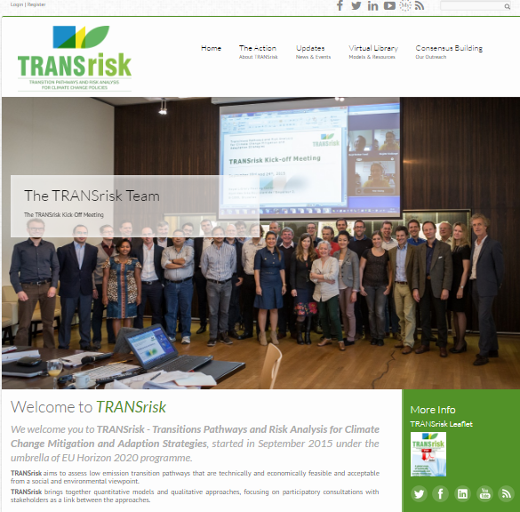
How to Contact us (1/2)
Visit our Website:
www.transrisk-project.eu
Contact e-mail:
info@transrisk-project.eu
contact@transrisk-project.eu
Like us on Facebook: transriskEU
Follow us on Twitter: @TRANSrisk_EU
Find us in LinkedIn: TRANSrisk_EU
Watch us on YouTube: TRANSrisk
Notes:
If you want to find out more about the TRANSrisk project there is lots of information on our website.
You can also follow us on Facebook, Twitter and LinkedIn, and watch our videos on YouTube.

